Slide 1
Programming Fundamentals
BY
Adnan Amin
Lecturer, IMSciences Peshawar

Slide 2
Overview: File Handling

Slide 3
Overview
So far, No permanent storage was required because data written to memory (RAM) only required reference variables.
When a program ends, data in RAM/variables vanish.
If a program is to retain data between runs, it must have a mechanism for doing so.
Data is saved in a file, which is typically located on the hard disc of a computer.

Slide 4
Types of Files
Python allows you to work both text files and binary files
Text files
ASCII or Unicode encoding schemes are used to encode data in a text file. It doesn't matter if the file contains numbers; they're all encoded as characters.
Binary files
A binary file contains unconverted (to text) data. A binary file contains data that only a program can read. As a result, a text editor cannot read binary files.

Slide 5
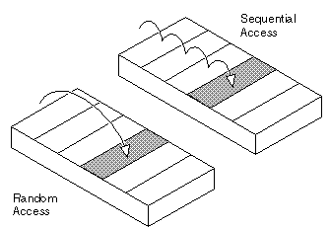
File Access Methods
Most programming languages support sequential and direct (random) file access.
Sequential File access:
We can read data from the file's start to finish. To read data at the end of a file, you must first read all data before it. E.g., cassette tape players
Direct/Random file access:
You can skip to any data in the file without reading the data before it and access data from any location. E.g., CD Player

Slide 6
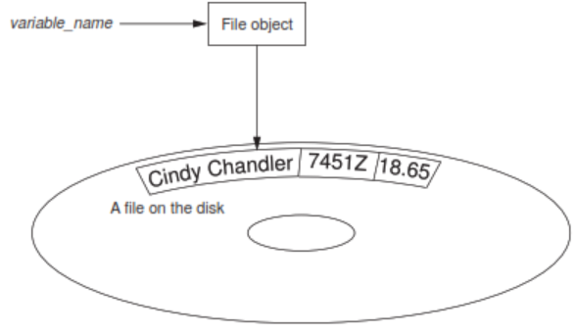
Filename, file extension, file object
Filename:
Each operating system has its own rules for naming files, the fact that files are identified by a filename. E.g., myfile
File extension:
File extension is a short sequences of characters that appear at the end of a filename preceded by a period. E.g., myfile.txt
File object:
a program's way of working with a file. A program variable points to the file object. This variable is used to perform file operations.

Slide 7
File Operations
Opening a file
1
Writing data to a file
2
Reading data from a file
3
Appending data to an existing file
4
Records processing
5

Slide 8
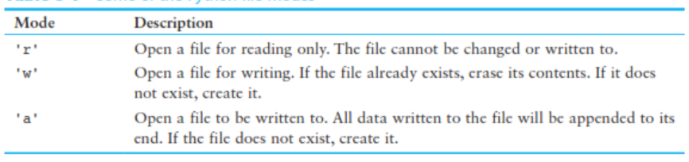
1. Opening a file
Basic syntax:
file_variable = open(filename, mode)
file_variable: is the name of the variable that will reference the file object.
Filename: is a string specifying the name of the file.
Mode:

Slide 9
Example: creating and opening a file
var_file = open(‘myfile.txt', ‘r’)
After this statement executes, the variable var_file will reference a file object that can be used to read data from the “myfile.txt” file.
Remember: by default, the file’s path is the same as that of the program.
var_file = open( r ‘c:\my documents\python\myfile.txt’, ‘r’)
The r prefix indicates a raw string. The Python interpreter reads the backslashes as literal backslashes.
var_file = open(‘myfile.txt’, ‘w’)
var_file = open(r ‘c:\my documents\python\myfile.txt’,’w’)
Note: When you use the 'w' mode to open an output file and a file with the specified filename already exists on the disk, the existing file will be erased and a new empty file with the same name will be created.

Slide 10
2. Writing data to a file
File objects have a method named write that can be used to write data to a file.
Syntax:
file_variable.write(string)
file_variable: is a variable that references a file object.
String: is a string that will be written to the file.
E.g., var_file.write(‘IMSciences’)
Use the file object’s close method to close a file.
var_file.close()

Slide 11
Example: This program writes three lines of data
def main():
var_file = open(‘myfile.txt', 'w’) # Open a file named myfile.txt.
var_file.write(‘Welcome\n’) # Write the 3 lines text to a file.
var_file.write(‘to Python\n’)
var_file.write(‘file handling\n')
var_file.close() # Close the file.
main() # Call the main function.

Slide 12
Example: Reading data from file
def main():
var_file = open(‘myfile.txt', 'r’) # Open a file myfile.txt.
file_contents = var_file.read() # Read the file's contents.
var_file.close() # Close the file.
print(file_contents) # Print the data that was read into memory.
main() # Call the main function.
Note: Although the read method allows you to read a file's entire contents in one statement, many programs need to read and process files one at a time.

Slide 13
Use readline to read a line from a file. (A line is just a string of characters that ends in n.)
# This program reads the contents of the myfile.txt one line at a time.
def main():
var_file = open(‘myfile.txt', 'r’) # Open a file named myfile.txt
line1 = infile.readline() # Read three lines from the file.
line2 = infile.readline()
line3 = infile.readline()
var_file.close() # Close the file.
print(line1) # Print the data that was read into memory.
print(line2)
print(line3)
main() # Call the main function.

Slide 14
Concatenating a newline to a string
def main():
print('Enter three names’)
first = input(‘Name #1: ‘)
second = input(‘Name #2: ‘)
third = input(‘Name #3: ‘)
var_file = open(‘myfile.txt', 'w')
var_file.write(first+ '\n’)
var_file.write(second + '\n’)
var_file.write(third + '\n’)
myfile.close()
print('The names were written to myfile.txt.’)
main()

Slide 15
Striping: (\n)
The \n serves a necessary purpose inside a file: it separates the items that are stored in the file.
If you want to remove the \n from a string after it is read from a file.
“strips” specific characters from the end of a string.
“rstrip” strips characters from the right side of a string.
For example:
msg = ‘Hello Students\n'
name = msg.rstrip('\n')

Slide 16
This program reads the contents of the file one line at a time and remove \n.
def main():
var_file = open(‘myfile.txt', ‘r’)
line1 = var_file.readline()
line2 = var_file.readline()
line3 = var_file.readline()
line1 = line1.rstrip('\n')
line2 = line2.rstrip('\n')
line3 = line3.rstrip('\n')
infile.close()
print(line1,line2,line3)
main()

Slide 17
Appending Data to an existing File
'w' mode: open a new empty file with the specified filename already exists on the disk.
If you want to preserve an existing file and append new data to its current contents.
use the 'a' mode to open an output file in append mode, which means
the following.
If the file already exists, it will not be erased. If the file does not exist, it will be created.
When data is written to the file, it will be written at the end of the file’s current contents.

Slide 18
Assume the file myfile.txt contains some data, each in a separate line:
var_file = open(‘myfile.txt', 'a’)
# appends three addtional lines to its existing contents
var_file.write(‘welcome\n’)
var_file.write(‘to \n')
var_file.write(‘Pythan\n')
var_file.close()

Slide 19
Writing and reading numeric Data
Strings can be written directly to a file, but numbers must first be converted to strings.
The str function in Python converts a value to a string.
def main():
var_file = open(‘intData.txt', 'w’)
num1 = int(input('Enter a number: '))
num2 = int(input('Enter another number: '))
# Write the numbers to the file.
var_file.write(str(num1) + '\n’)
var_file.write(str(num1) + '\n’)
var_file.close()
print('Data written to intData.txt’)
# Call the main function.
main()

Slide 20
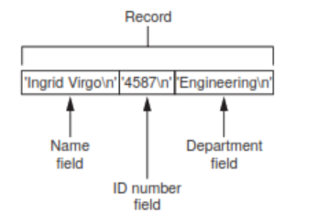
Processing records
The data that is stored in a file is frequently organized in records.
A record is a complete set of data about an item, and a field is an individual piece of data within a record.
A file's data is often organized into records and fields. A field is a single piece of data within a record.
E.g., Assume we want to store employee data in a file. Each employee will have their own file. Each record will have fields like name, ID, and department.

Slide 21
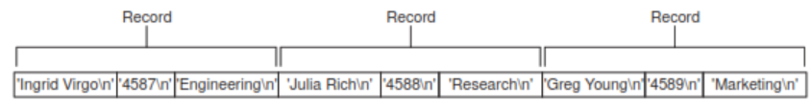
def main():
num_emps = int(input('How many employee' + \ 'do you want to create? ‘)) # Get the number of employee records to create.
emp_file = open('employees.txt', 'w’) # Open a file for writing.
for count in range(1, num_emps + 1): # Get each employee's data and write it to the file.
print('Enter data for employee #', count, sep=‘’) # Get the data for an employee.
name = input('Name: ‘)
id_num = input('ID number: ‘)
dept = input('Department: ‘)
emp_file.write(name + '\n’) # Write the data as a record to the file.
emp_file.write(id_num + '\n’)
emp_file.write(dept + '\n')
print() # Display a blank line.
emp_file.close() # Close the file.
print('Employee records written to employees.txt.')
main() # Call the main function.

